Slide 1
Dridi‘Chiheb’ {
GeekSlayer.html
Style.css
[Geek Slayer]
< Anime/Gaming Website >
}
Programming Language

Slide 2
What is‘GeekSlayer’;
GeekSlayer.html
Style.css
Geek Slayer is a website I have created is a dynamic and interactive platform dedicated to the world of anime.
It utilizes JavaScript HTML CSS and bootstrap to provide a seamless user experience with dynamic and responsive elements on the page.
The website features a login and sign-up page, allowing users to access personalized content and engage with other members of the community. HTML serves as the structural backbone of the platform, ensuring that all pages are properly formatted and easily accessible.
My expertise in web development also extends to responsive design techniques, ensuring that the website looks great and is easy to navigate on all devices, including desktops, laptops, tablets, and smartphones.
Programming Language

Slide 3

‘Martin Fowler’ said {Any fool can write code that a computer can understand. Good programmers write code that humans can understand. }

Slide 4

GOMYCODE {
GOMYCODE.com
workshop.css
Big cheers to GMC , GOMYCODE was established in 2017 on account of our enthusiasm for the digital world, and to connect the gap that exists between what the standard training offered and what the accessible job offers on the market. >
}
Programming Language

Slide 5
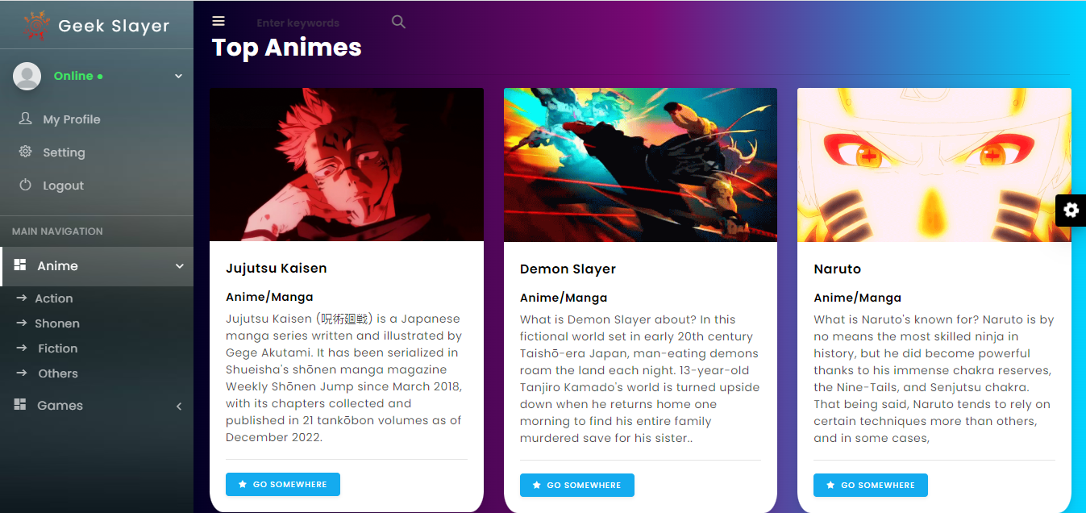
Geek Slayer {
GeekSlayer.html
Style.css
<This Is how the website looks and you Can check It more by moving between the pages>
}
Programming Language

Slide 6
Thanks For { Your Attention; }
GeekSlayer.html
Style.css
Programming Language

